Slide 1
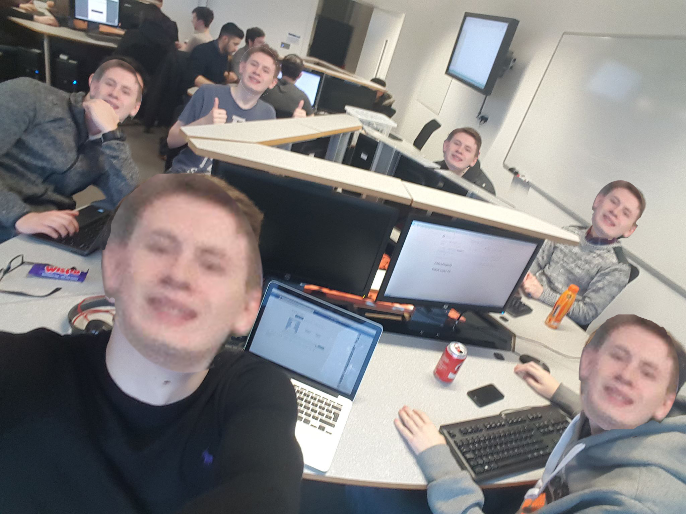
Space Hunt👻
Jamie Euan Erik Conor Tom Patryk

Slide 2
Idea
Space Bargain hunt (Called Space Hunt)
Searching for minerals, materials etc. throughout different planets
Spaceship being the Player Controlled Object
Gravity implemented around planets
Fuel indicator
Speed indicator
CON

Slide 3
Merge Sort
Merge Sort
It breaks down the array into smaller chunks and then reorganises them to form the sorted list.
Its used in the program to sort the inventory list ordered by the numeric value (price)
We needed a fast sorting algorithms due to the fact that Pygame has struggled with memory and performance right from the start.
Euan

Slide 4

What went well
The program has developed from the initial idea
A lot more functions have been added
GUI Looks good
Player control function enabled
Python knowledge improved
Jam

Slide 5
What could be improved
Group roles
GITHUB usage/knowledge
Having issues implementing Search algorithm, which we
are working to fix.
PAT

Slide 6

What changed during the project
The switch from 2D to 3D
Language change from Python to C++ and back to Python
ERIK

Slide 7
Difficulties we faced
Learning Pygame
Learning GUI programming
Getting to work with GITHUB
Creating the algorithms
TOM

Slide 8
CODE PRACTICES
Commenting Code
Grouping together similar functions
Saving files with suitable names
Commit messages
Pat

Slide 9
Working example

